Slide 1
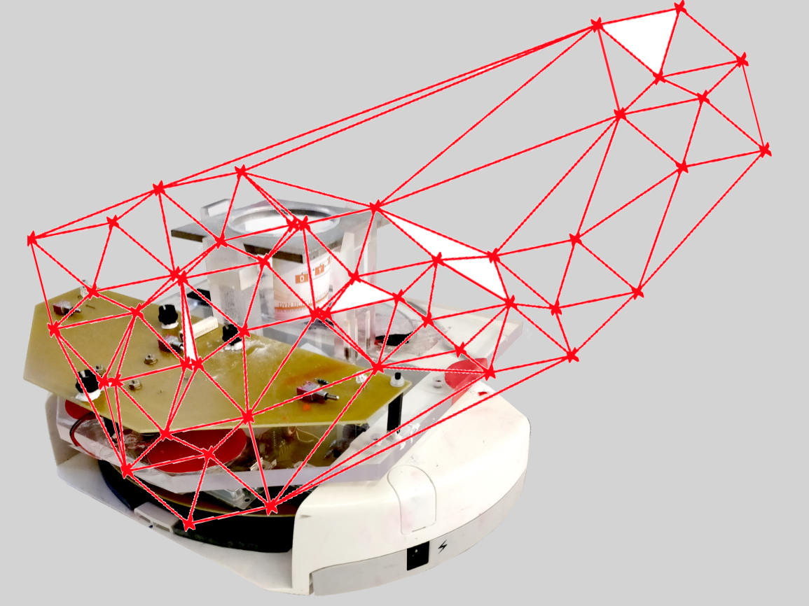
Project group SS18
Development of local positioning system for a pipe-less plant

Slide 2
Task for the week
Connection between RFID & Wifi Module
Send Data to GUI and print it on the Terminal Window

Slide 3
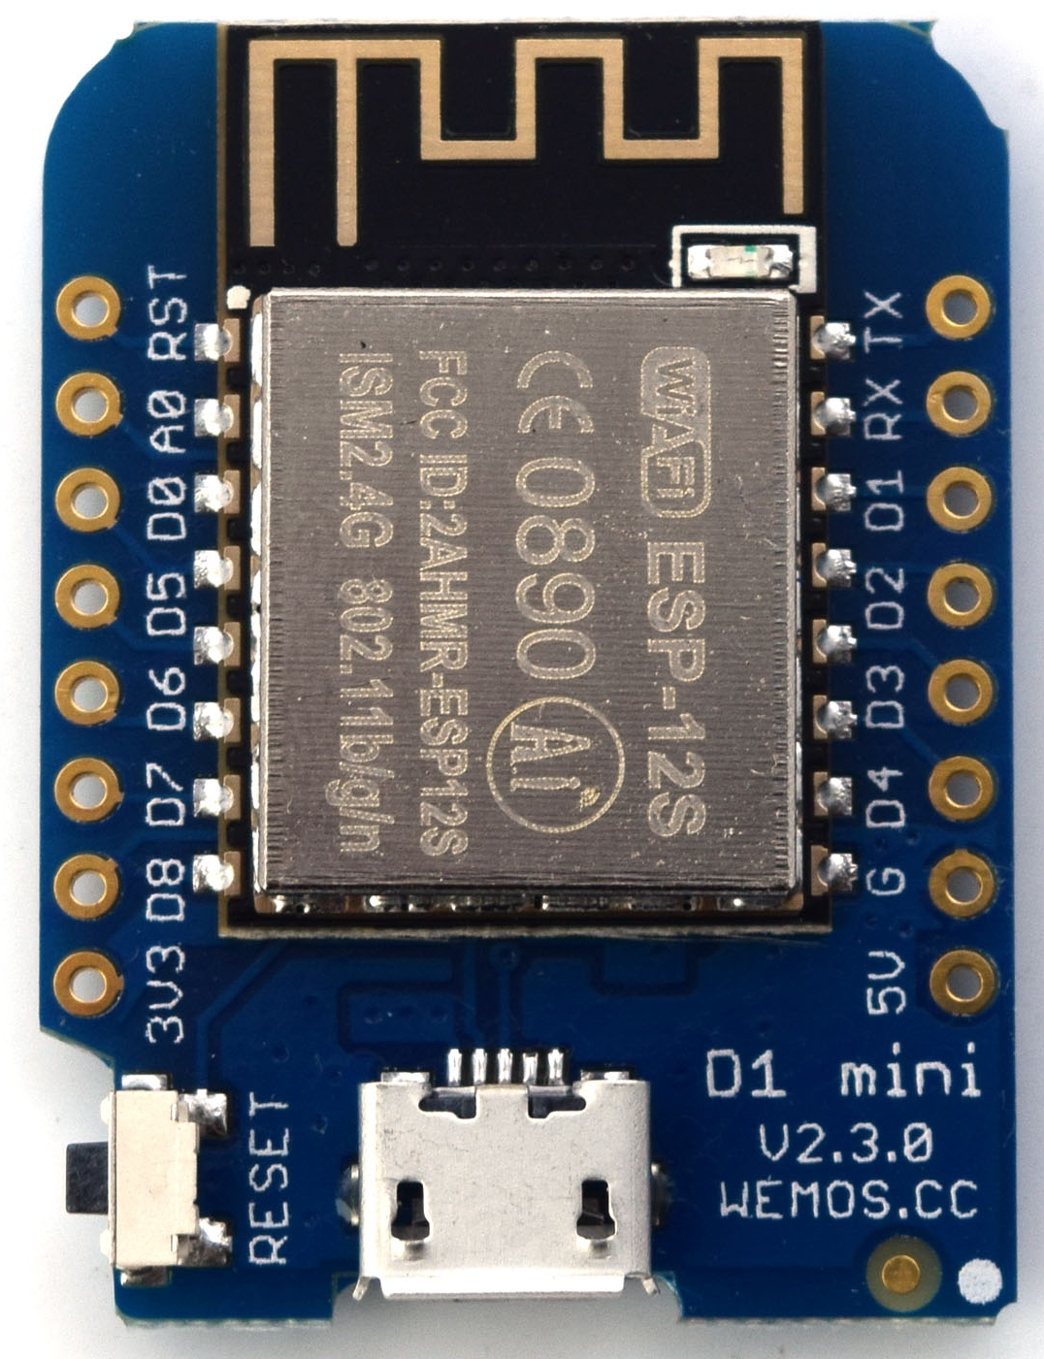
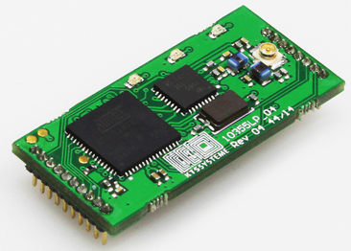
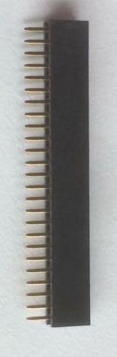
KTS Kit
V5 & GNG from Robot microcontroller
TX/RX to the Wifi Module pins D5/D6

Slide 4
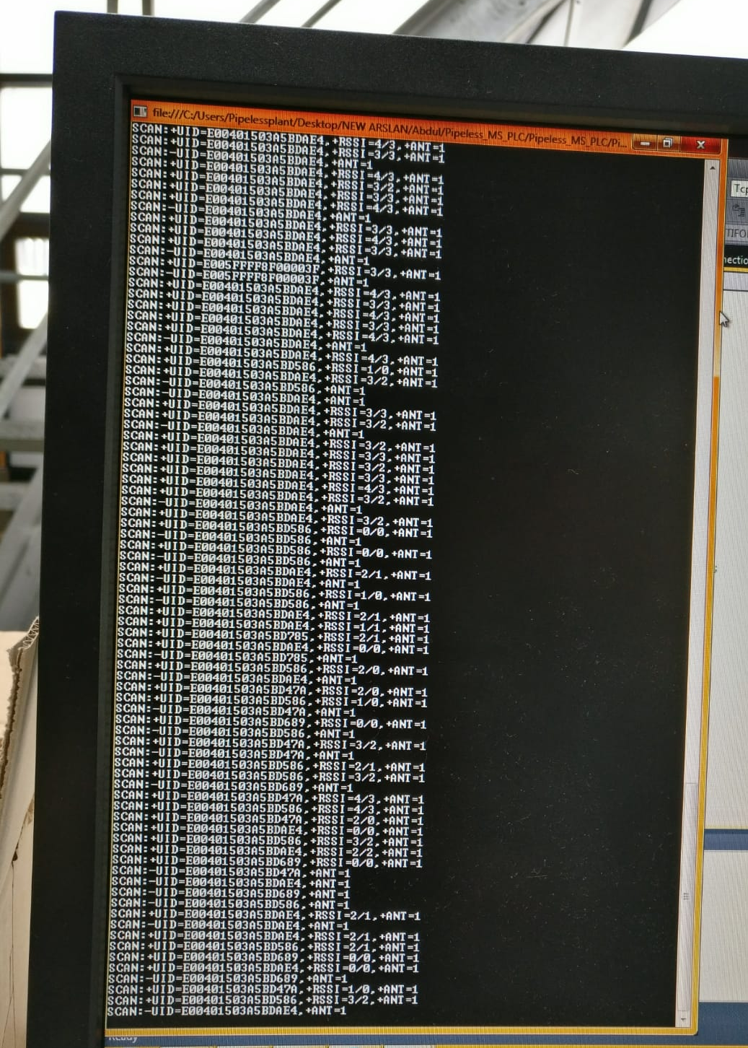
Receiving Data to GUI
When receive (red led in RFID blinks): UID + RSSI
No Data receive (no red blinking + Tag detected): UID
No Data receive no data: null

Slide 5
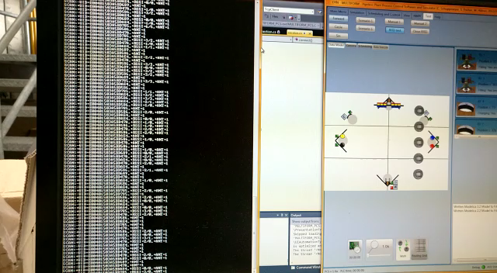
Receiving to GUI

Slide 6
Task for the week
Transfer Reader-Data to VisualStudio
Take Data out of the String
Use the Data as it was done in the Emulator

Slide 7
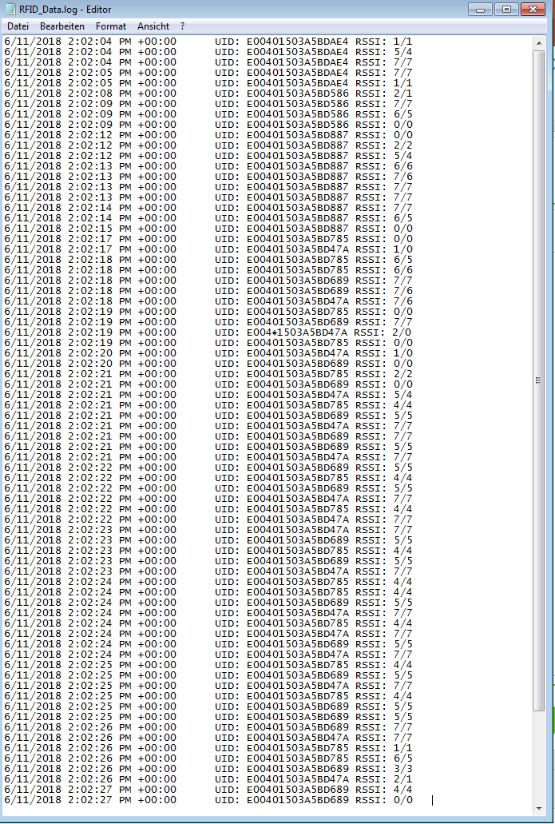
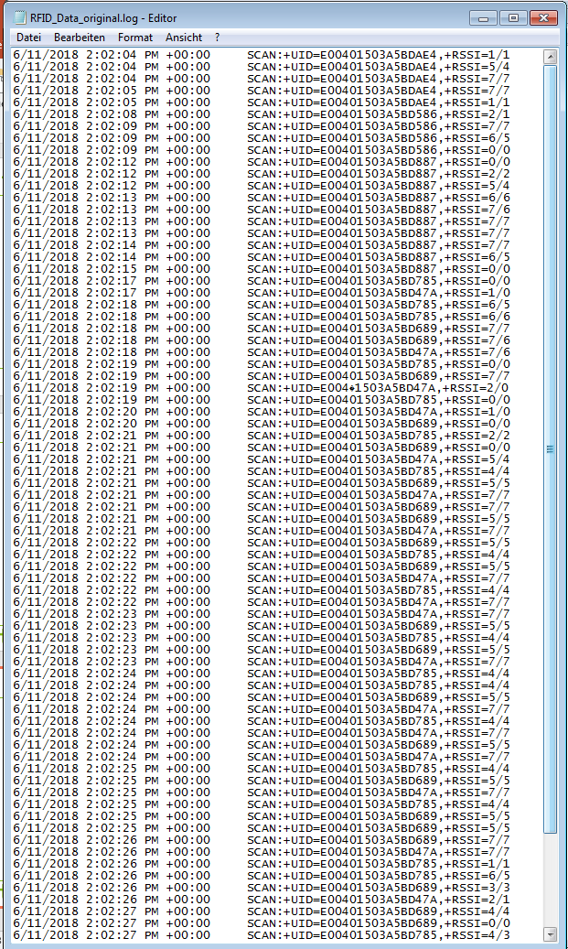
.LOG File

Slide 8
RSSI -> Distance [cm]
The relation between RSSI and distance between origin of the antenna and the tag is inconsistent
Tag
Reader

Slide 9
Ideas to solve this problem
For the different possibilities solve the trilateration and check which of the combination has the highest probability of being true
Compare the new positions with the last position
Big jumps not possible

Slide 10
Possible reasons
The field and the inductor of the tag are perpendicular
1,5 cm

Slide 11
Future
Update the Emulator
Update the C# Code to solve trilateration

Slide 12
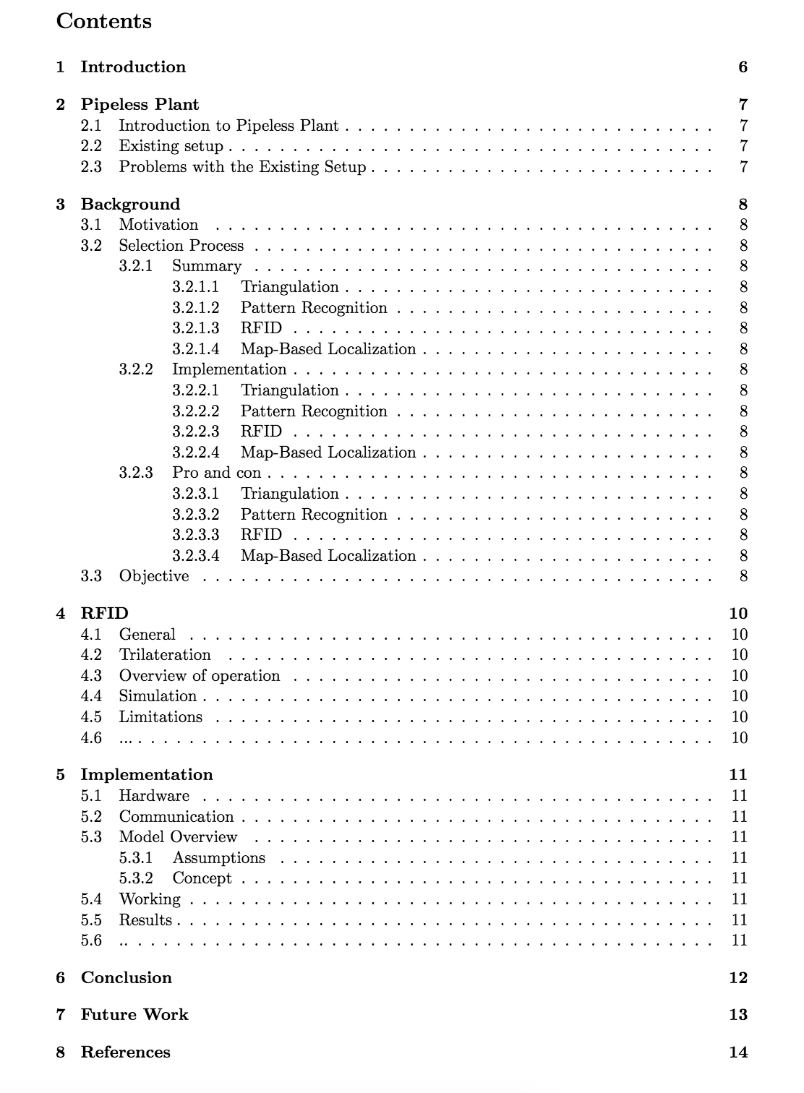
Report Structure

Slide 13
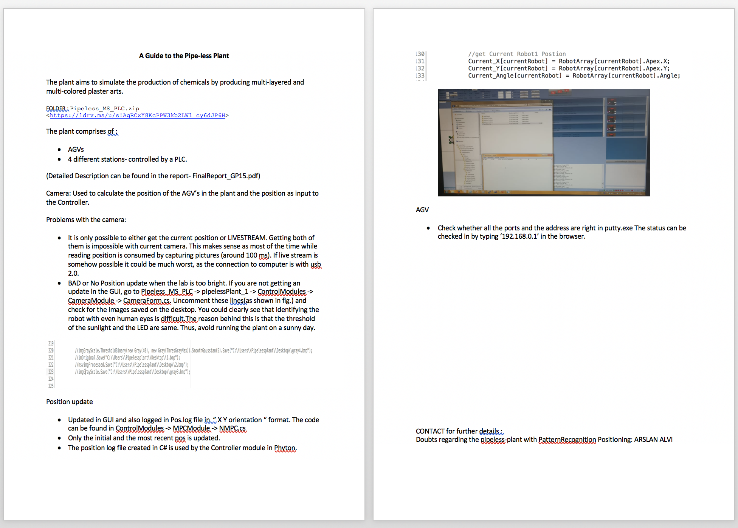
About the pipeless plant

